Slide 1
TWACH: THE BIAS PLATFORM [Twitter Sentiment Analysis]
Using a modified Naïve Bayes Classifier
Special thanks to the guidance Dr. DHARAMPAL SINGH
TEAM:
ANJAN KUMAR DEY
ASHISH ABHISHEK MINZ
AYAN CHATTERJEE
DEBAJYOTI GHOSH
DEBRAJ KARMAKAR

Slide 2
OVERVIEW
This project is a web application which is used to analyze the tweets about a certain topic using a hashtag or a certain person using their username.
We will be building a classifier to perform sentiment analysis of these tweets to determine whether they are positive, negative or neutral.
This application can be used by any organization office to review their works or by any other company to review their products or brands.
The main feature of our application is that it helps to determine the public opinion about the products, government work, politics or any other by analyzing the tweets.

Slide 3
AIM
Build a classifier.
Extract tweets and classify them into positive, negative or neutral.
Analyse tweets to get public sentiment about a product, service topic (using a hashtag or username).
Implement a web application.

Slide 4
APPLICATIONS
Some Useful applications are :
For reviewing public opinion on products and any trending topic
For Business Intelligence
For Political Analysis
For Healthcare
For marketing

Slide 5
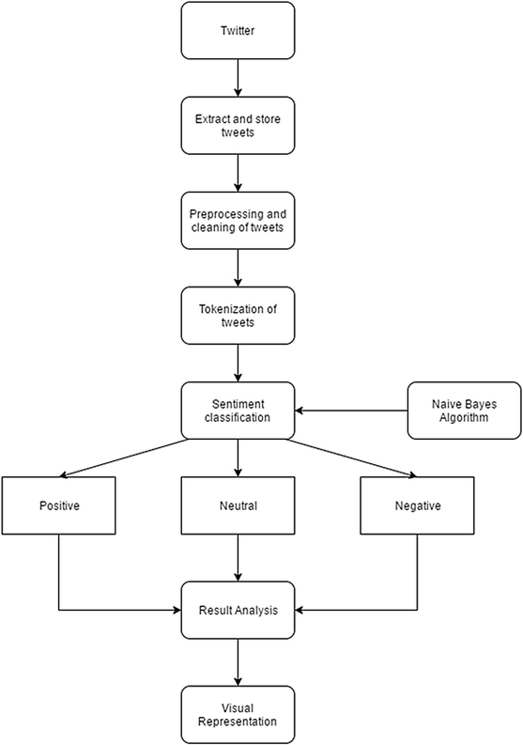
WORK FLOW DIAGRAM

Slide 6
SYSTEM DESIGN
INPUT (KEYWORD is hashtag or username)
TWEETS RETRIEVAL(through Tweepy)
DATA PREPROCESSING
SENTIMENT IN GRAPHICAL REPRESENTATION
CLASSIFIED TWEETS
CLASSIFICATION ALGORITHM

Slide 7
CLASSIFIER
Machine Learning algorithm used is Naïve Bayes.
Balanced dataset used for training - from Kaggle.
Preprocessing data (cleaning data done using NLP methods).
Split train and test the dataset.
Model Building - using sklearn library.

Slide 8
CLASSIFYING TWEETS
Naive Bayes Classifier handled two classes originally (negative and positive). We extended the Naive Bayes Classifier to handle 3 classes: positive, neutral, and negative. By taking the difference of p_pos and p_neg as a polarity score (polarity = p_pos - p_neg), we have classified the three classes as such:
Positive: if the polarity score is more than or equal to 0.2.
Negative: if the polarity score is less than or equal to - 0.2.
Neutral: if the polarity score is between 0.2 and -0.2.

Slide 9
WEB APPLICATION
UI- built using css and html and streamlit - an open source Python library.
Backend- Python3 and it’s libraries have been used.
The application will be hosted using heroku.
Some libraries used:
Tweepy- used to extract the tweets
NLTK(Natural Language Toolkit)- used to clean the tweets
SKlearn and Textblob- for ML tools and common NLP tasks.

Slide 10
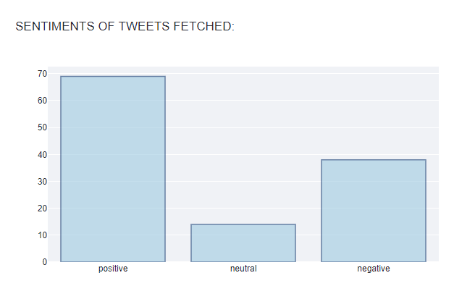
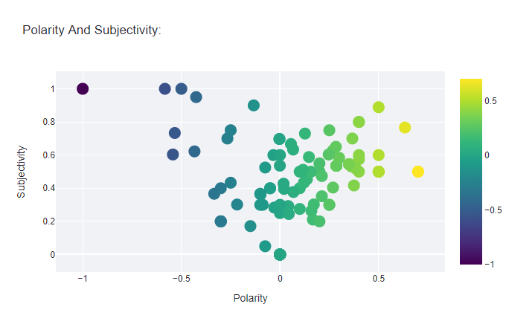
VISUALIZING DATA
Scatter plot
Bar graph

Slide 11
SNAPSHOTS OF WEB APP
Using an example through a hashtag

Slide 12
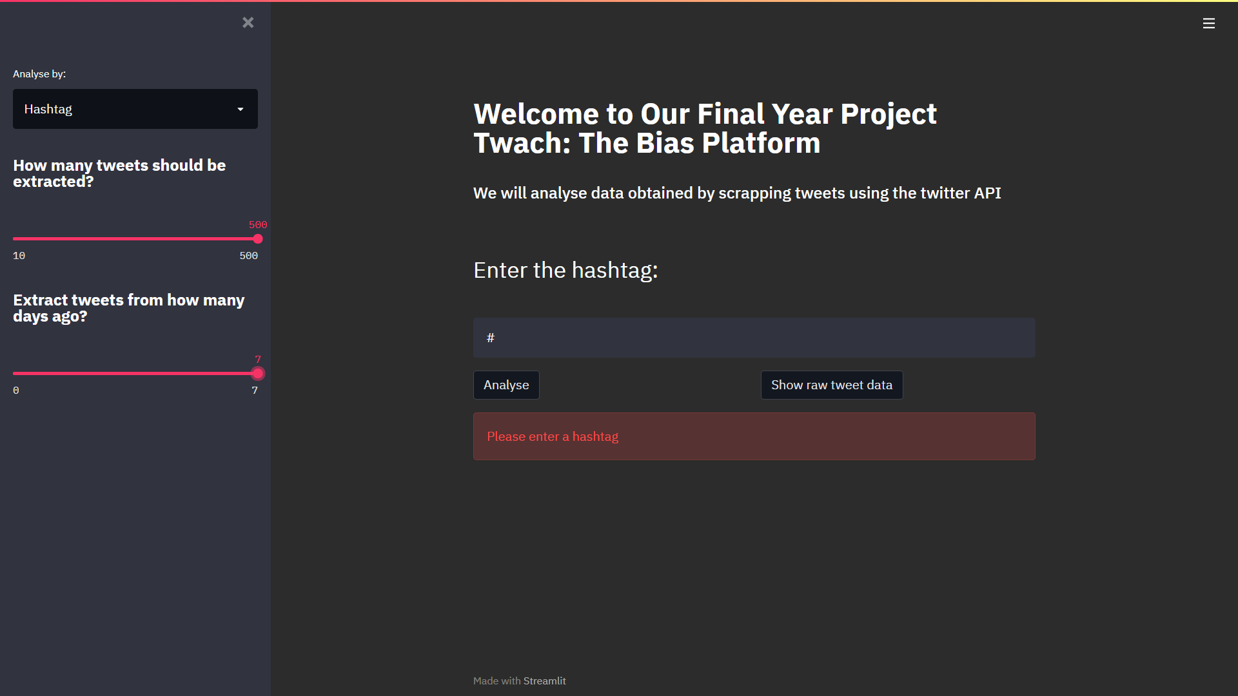

Slide 13
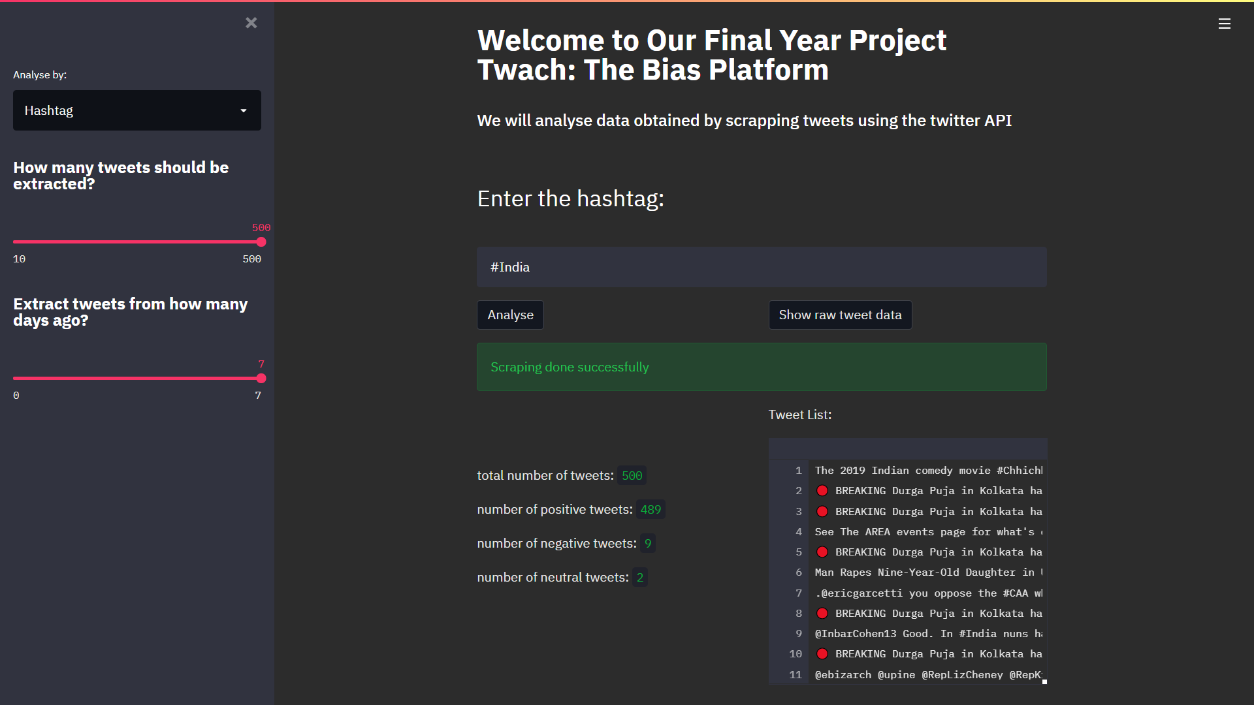

Slide 14
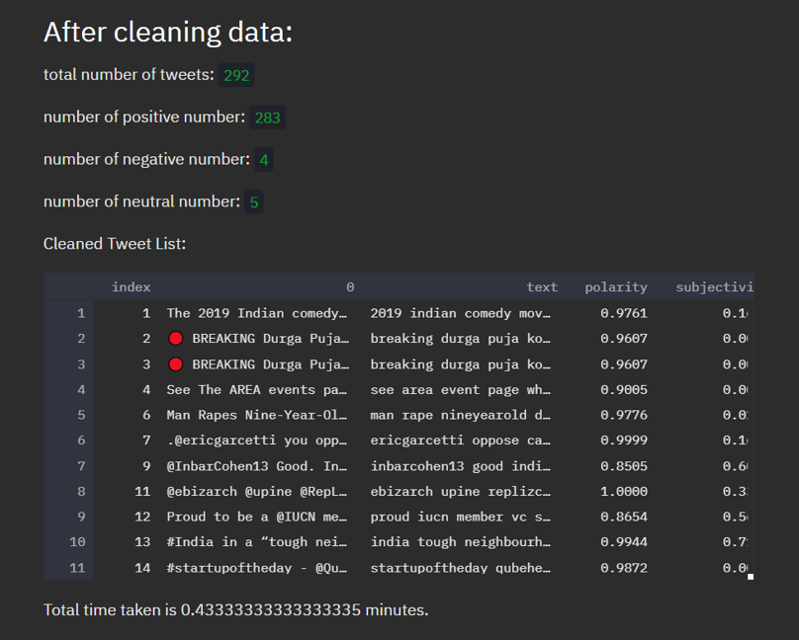
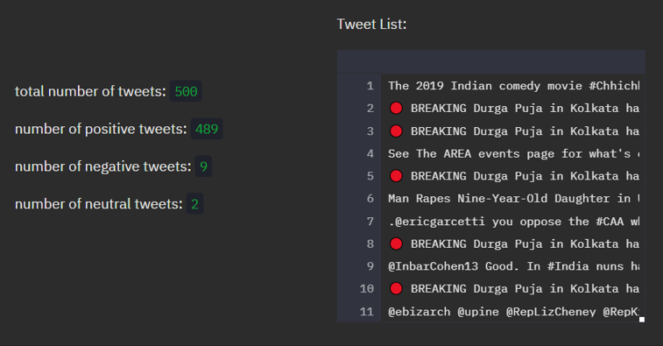

Slide 15
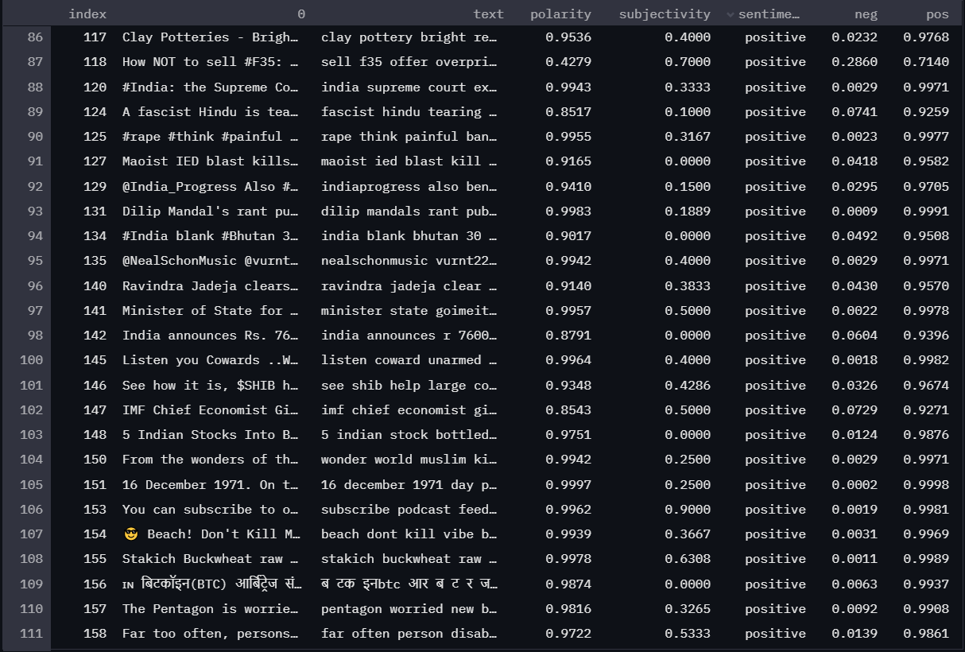

Slide 16
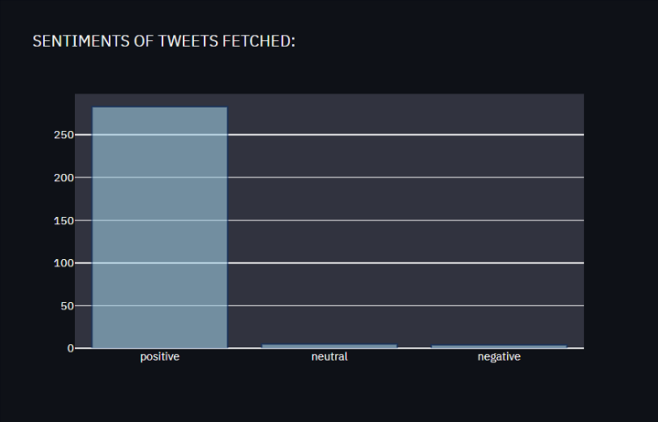
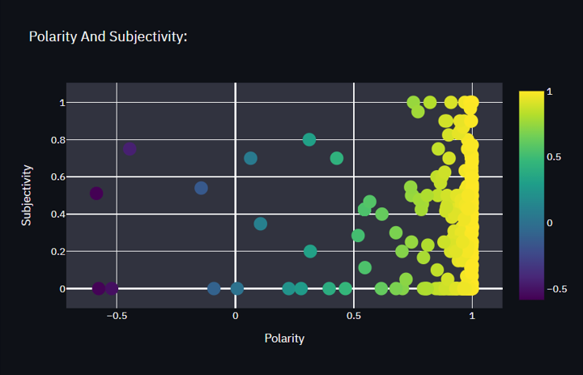

Slide 17
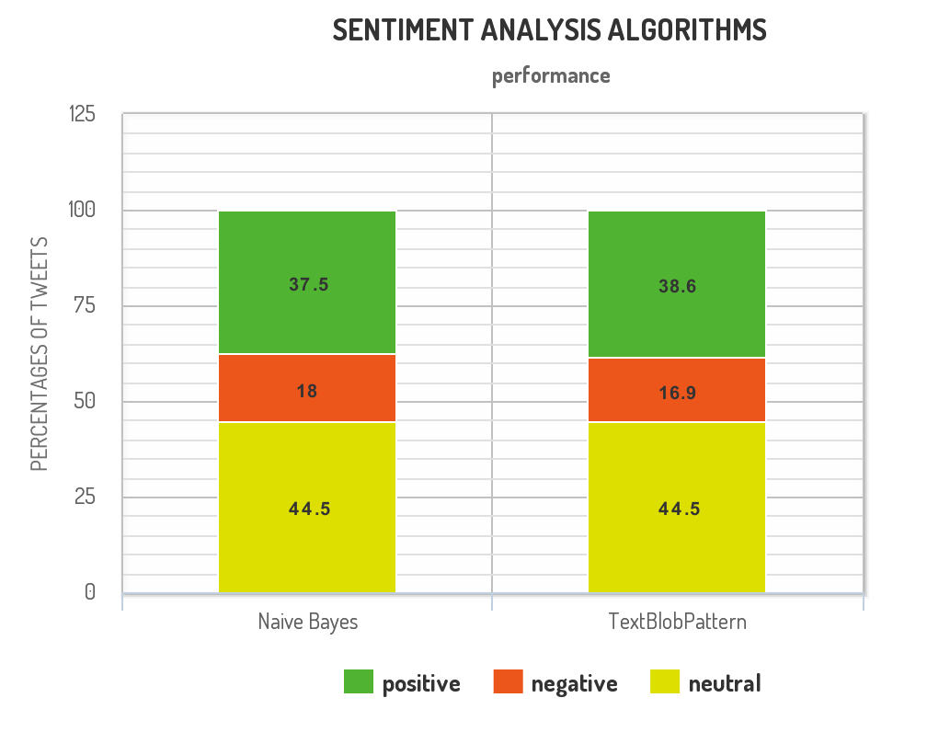
RESULTS AND DISCUSSION
When comparing our algorithm to the TextBlob inbuilt PatternAnalyzer to classify tweets, we got the following results:
Thus we see that the tweet classification is almost the same whether using our simple modified Naive Bayes model where using machine learning, the computer automatically learned what words are associated with a positive or negative rating or TextBlob’s PatternAnalyzer which uses the pattern library which is handtagged with values for polarity and subjectivity.

Slide 18
LIMITATIONS
Identifying subjective parts of text
Sarcasm Detection
Entity Recognition
Linguistic differences over different languages

Slide 19
CONCLUSION AND FUTURE SCOPE
We have demonstrated the application of sentiment analysis in social media through making a web app. Therefore by entering a keyword, we may get the visual representation of the tweets analysed (positive, negative or neutral) as well as the polarity and the subjectivity through the web app using the Naive Bayes Algorithm.
Sentiment Analysis, especially in the domain of micro-blogging is still in the developing stage and far from being complete.
Future Scope:
We may find more reliable sources from other social media platforms like Facebook, Instagram, Youtube, LinkedIn, etc.
We could further improve the classifier by using other algorithms and methodologies.

Slide 20
THANK YOU
Special thanks to the guidance Dr. DHARAMPAL SINGH
TEAM:
ANJAN KUMAR DEY
ASHISH ABHISHEK MINZ
AYAN CHATTERJEE
DEBAJYOTI GHOSH
DEBRAJ KARMAKAR

